Slide 1
Tribal TAB Program
Providing “Technical Assistance to Brownfields” to all U.S. Federally Recognized Tribes!

Slide 2
Tribal TAB in Alaska
In Partnership with: the Division of Community Health Services| Alaska Native Tribal Health Consortium
(ANTHC)

Slide 3
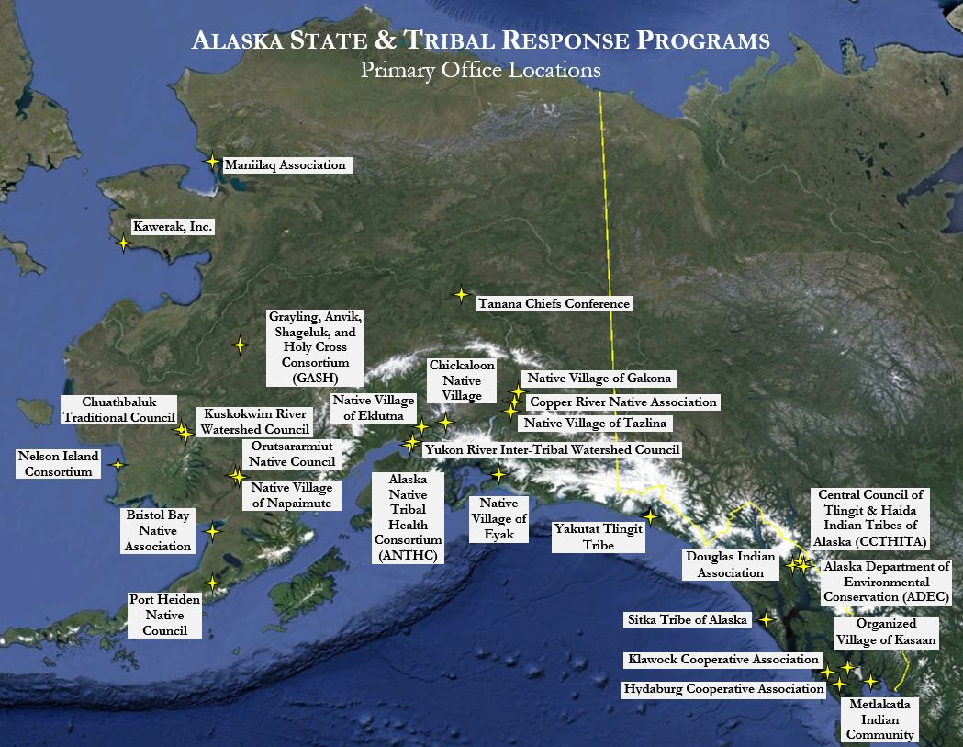

Slide 4
ANTHC TRP Role:
Leading development of online Tribal Brownfields Forum
Forum using similar framework to LEO Network
Act as ongoing technical assistance hub for Alaska tribes

Slide 5
Purpose & Scope of the TRP
CERCLA 128(a):
Tribal Response Program
(TRP)
Tier I: Module 1

Slide 6
What is the TRP for?
Responding to releases of:
hazardous substances, pollutants or contaminants;
Petroleum;
Controlled Substances (e.g. Meth); and
Releases from “Mine scarred Lands”
(past, present and future)

Slide 7
What is the TRP for?
Identifying and assessing “Brownfields”
(What is a Brownfield? See Element 1!)
Tribes protecting public health and the environment
You and your community!

Slide 8
Ina Nez Perce – Director Tribal Env. Dept.
Fort Belknap Indian Community, MT

Slide 9
Know the
Govt. Agencies
alphabet soup

Slide 10
Learn the Language of TRP Acronyms
EPA
QAPP
FSP
HSP
RQ
IC
PPM
CERCLA
RCRA
TSCA
CWA
UST/LUST
TBA
SNAFU
ND
etc.
Note: never trust an
acronym
Notes:
See Appendix

Slide 11
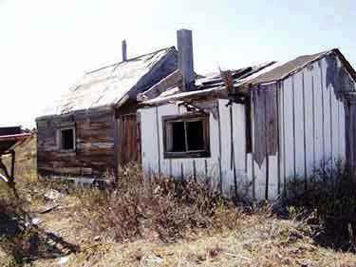
TRP is intended to address:
“Brownfields” and other sites past, present and future

Slide 12
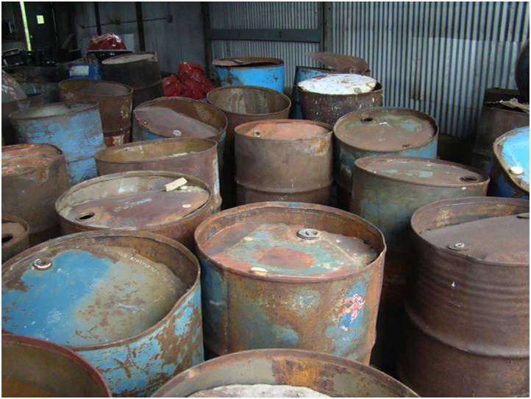
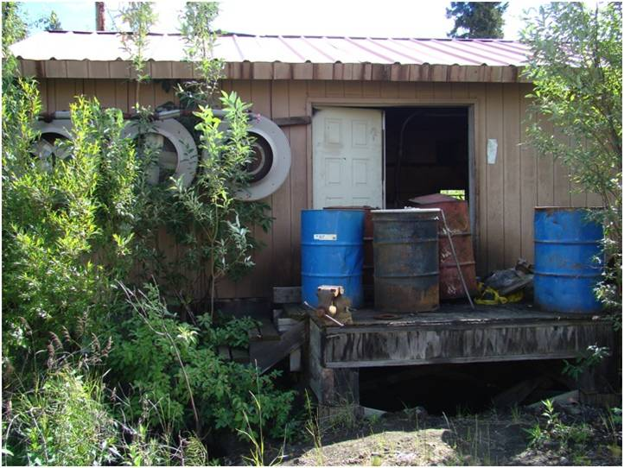
TRP is intended to address:
Releases of “hazardous substances, pollutants or contaminants” …
(as defined under several laws)

Slide 13
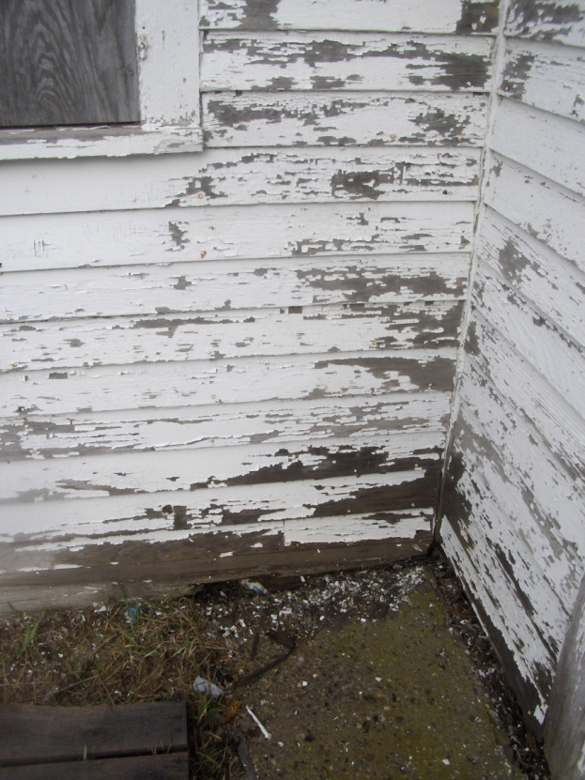
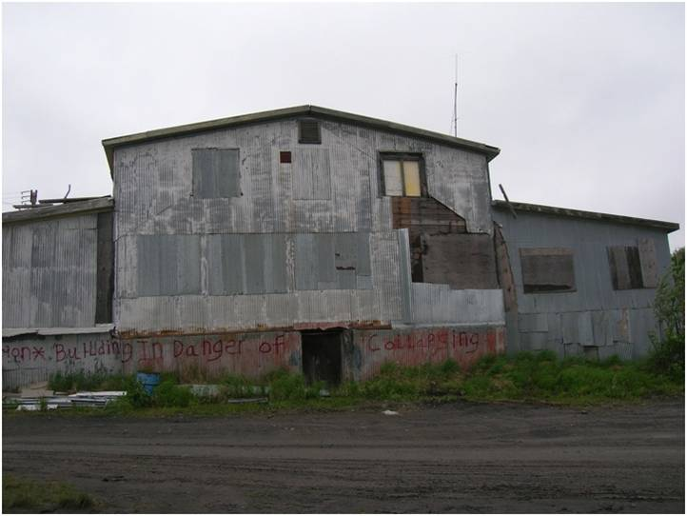
TRP is intended to address:
Asbestos & Lead Paint Releases

Slide 14
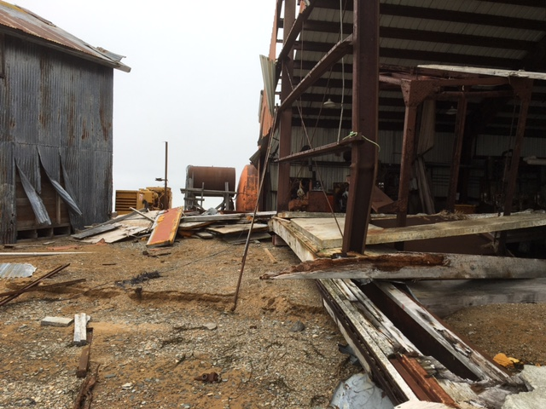
TRP is intended to address:
Golovin Community, AK
Brownfield sites impacted by Climate Change

Slide 15
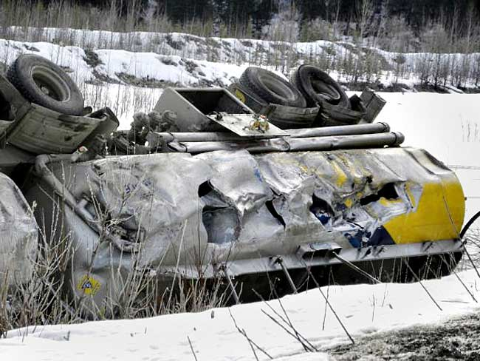
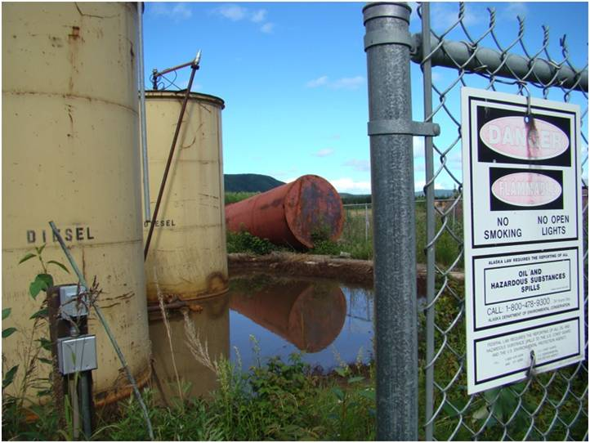
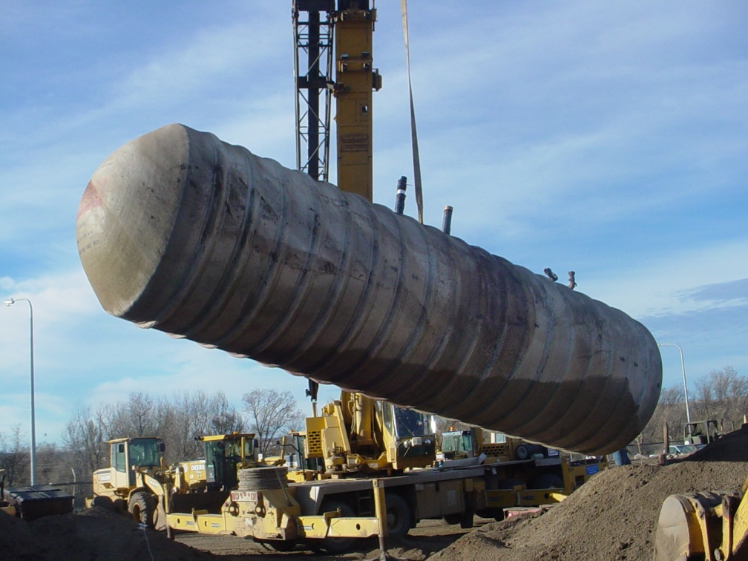
TRP is intended to address:
Releases of petroleum

Slide 16
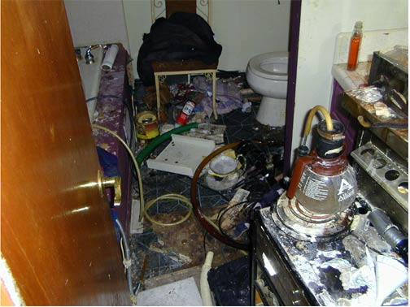
TRP is intended to address:
Releases of controlled substances
Meth
Lab

Slide 17
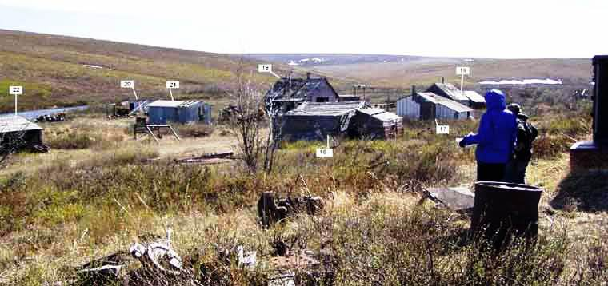
TRP in intended to address:
Mine Scarred Lands

Slide 18
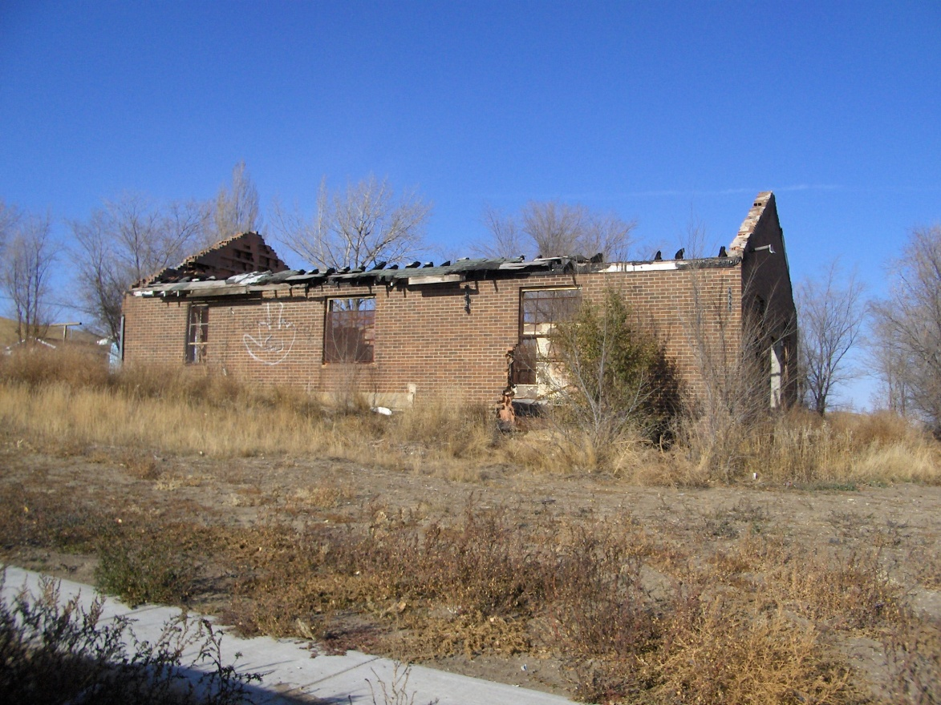
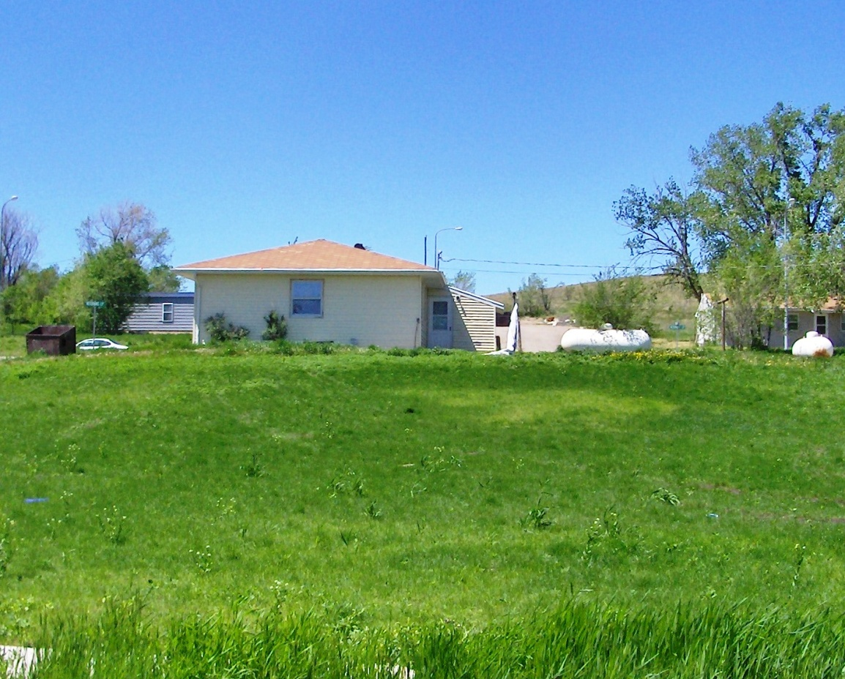
Change This
To This
&
Eventual Reuse

Slide 19
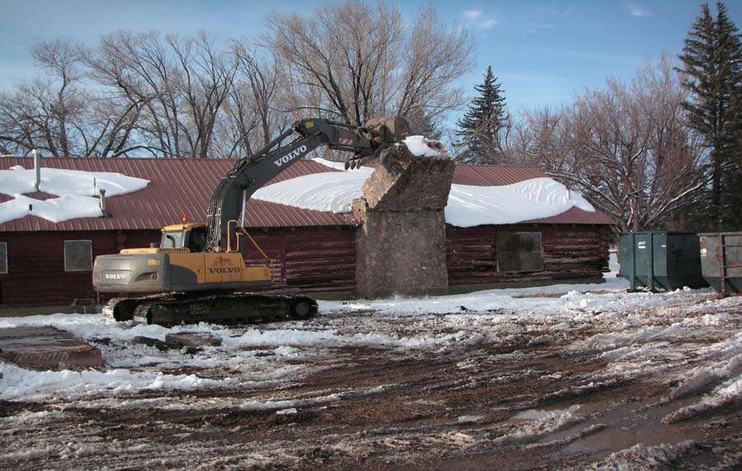
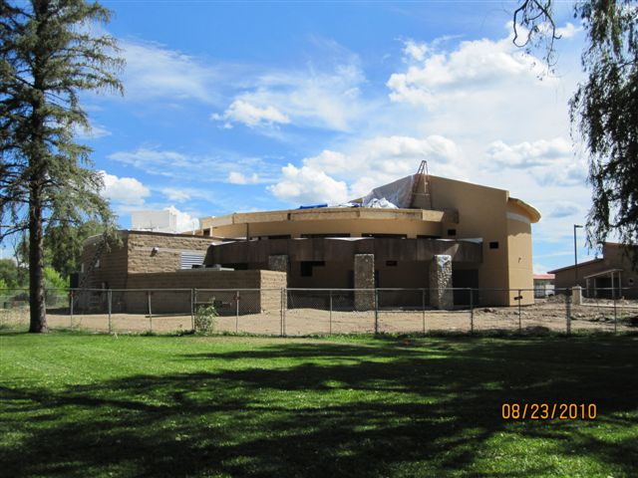
Replace This
With This
(Southern Utes Tribal
Multi-purpose Bldg.)

Slide 20
The “Law”
Small Business Liability Relief and Brownfields Revitalization (SBLRBRA, hereafter referred to as the “Brownfield Law”) passed by Congress in 2002.
Amended the Comprehensive Environmental Response, Compensation, and Liability Act of 1980 (CERCLA aka Superfund)

Slide 21
The “Law”
Added to Section101 (Definitions):
(39) (A) IN GENERAL.—The term ‘‘brownfield site’’ means real property, the expansion, redevelopment, or reuse of which may be complicated by the presence or potential presence of a hazardous substance, pollutant, or contaminant.

Slide 22
Translation?
Buildings and/or land/waters that may be contaminated with one or more hazardous substances and the possible contamination is preventing or discouraging use or restoration of those buildings or land, as well as posing a risk to public health and safety and/or the environment.

Slide 23
The “Law”
Added: Section 128(a) ASSISTANCE TO STATES and TRIBES (1) IN GENERAL.*
STATES and TRIBES.—The Administrator may award a grant to a State or Indian tribe that: (i) has a response program that includes each of the elements, or is taking reasonable steps to include each of the elements.
*Updated in Federal Register 10/25/2016, effective 11/01/16

Slide 24
Tribal Response Program
Section 128(a) created the:
“Tribal Response Program” (TRP)
This is significant in that it treats Tribes the same as states!

Slide 25
The “Law”
Section 128(a)(1)(A)(i) lists the four elements of a State or Indian Tribe response program:
(1) Timely survey and inventory of brownfield sites.
(2) Oversight and enforcement authorities or other mechanisms, and resources, that are adequate to ensure that a response action will protect human health and the environment.

Slide 26
The “Law”
(3) Mechanisms and resources to provide meaningful opportunities for public participation.
(4) Mechanisms for approval of a cleanup plan, and a requirement for verification by and certification or similar documentation from the State, an Indian tribe, or a licensed site professional to the person conducting a response action indicating that the response is complete.

Slide 27
The “Law”
ALSO:
Section 128(b)(1)(C) requires a “PUBLIC RECORD” - the Public Record …..
{information on cleanup activities}
and
The Public Record shall contain information
on the use of “Institutional Controls” in the remedy of a site.

Slide 28
The “Law”
Notes:
Congress and the Law refers to both “response actions” and “cleanups” and the terms are used interchangeably.
Although Section 128 was originally titled “State Response Programs” it was later amended to "State and Tribal Response Programs“*
*Federal Register 10/25/2016 effective 11/01/16

Slide 29
128(a) Grant awarded:
to establish and/or enhance a response program
to take reasonable steps to include each of the 4 Elements
to establish & maintain a Public Record
and to increase the capacity of a Tribe to assess and cleanup contaminated sites and other releases

Slide 30
The “Law”
Notes:
For the purpose of this program the term "Indian tribe" means any federally recognized Indian tribe, band, nation, or other organized group or community, including any Alaska Federally Recognized Tribe (but not including any Alaska Native regional or village corporation), which is recognized as eligible for the special programs and services provided by the United States to Indians because of their status as Indians.
Tribal consortiums are also eligible for funding under this program.

Slide 31
Goals of EPA TRP Funding
Generally to increase tribal cleanup capacity and:
1) to ensure that tribal response programs include, or are taking reasonable steps to include, certain elements and establishes and maintains a Public Record; and
2) to provide funding for other activities* that increase the number of response actions conducted or overseen, by a tribal response program. (*including Site Specific Activities)

Slide 32
128(a) Grants
These are “Cooperative Agreements”*
These are not competitive grants
These are not the same as the competitive Section 104(k) Brownfield Assessment or Cleanup Grants
*NOTE: Can also be part of a “Performance Partnership Grant” (PPG)

Slide 33
EPA 128(a) Guidance
U.S. EPA Office of Brownfields Land Revitalization issues an annual 128(a) funding guidance each Fall:
“Funding Guidance for State and Tribal Response Programs, Fiscal Year 20XX”
NOTE: This guidance (EPA-560-F-15-198 month, year) is supplemented by the EPA Regions.

Slide 34
Impacts of 128(a)
Empowered Tribes to identify, inventory, assess and cleanup contaminated sites in Indian country not other wise being addressed.
The TRP has documented hazardous releases at some sites that have compelled a response action by federal agencies or other entities.
Enabled the Tribes to apply for grant funds to address some sites or take action themselves on other sites.
A big step forward in exercising tribal sovereignty and self implementation of tribal laws and codes to address such problems and prevent their reoccurrence.

Slide 35
Impacts of 128(a)
NOTE: All of these impacts may vary in their implementation from Tribe-to-Tribe depending on the provisions of treaties and other federal laws or acts of congress and any agreements or MOA/MOUs the tribe may have with federal agencies or states.
Consult appropriate legal expertise for any specific issues that may arise.

Slide 36
Impacts on Other Programs
Addressing solid waste issues including illegal and open dumping & screening open dump sites for hazards;
Development of tribal waste management laws/codes;
Development of civil compliance and enforcement procedures;
Assisting with addressing Lead and Asbestos exposures and abatements;
Assisting with development of tribal emergency response capacity;
Assisting with addressing leaking underground storage tanks (LUST) problems;

Slide 37
Impacts on Other Programs
Preventing or addressing releases from poor waste management practices;
Assisting tribal economic development or property offices with “Due Diligence” or “All Appropriate Inquiry”;
Assisting with development of Integrated Solid Waste Management Plans (ISWMPs); and
Creating public outreach materials and conducting public meetings and forums, sometimes in traditional languages.

Slide 38
Tribal Issues
Defining tribal jurisdiction for imposing or enforcing tribal civil laws and codes on members vs non-members and various land status (trust, fee, native corp.,etc.);
Researching the history and locating documents for tribal and other property;
How to impose “institutional controls” on land with differing status and coordinate such controls with boroughs, native corp., state and federal agencies (BIA, BLM, etc.);
Protection of sacred and culturally sensitive sites and related information;
Coordination with multiple tribal and federal authorities and agencies;

Slide 39
Tribal Lessons Learned
There are many more brownfields or other sources of releases on or near tribal lands and communities than originally anticipated;
Open dumping and poor waste management create releases of hazardous substances;
Most old structures have asbestos and lead paint problems;
New tribal laws, codes, procedures and policies are required to fully implement the program; and
There is a lot to learn, A lot of training is required.

Slide 40
Further Implementation
New discoveries of past releases or new releases of hazardous substances, pollutants or contaminants;
Continuing need to monitor and address activities that tend to create new releases from accidents and spills; industrial activities; mining and oil/gas exploration and production; construction and demolition; fires, aging existing buildings; and
Continuing need to monitor and address releases from waste management facilities and illegal dumping.
There is also the potential to provide technical support to other tribal programs and offices.

Slide 41
EPA Tribal Partnership
“Section 128(a) strengthens EPA’s partnerships with states and tribes, and recognizes the response programs’ critical role in oversight of cleanups. In addition, in contrast to some other environmental laws, the tribes are treated as an equal partner and do not need to petition the EPA for “treatment as a state” to implement the response program.”

Slide 42
Boyd Lopez - Spiritual Leader
Ute Mountain Ute Tribe, CO

Slide 43
References:
The “Brownfield Law” of 2002 (SBLR&BRA)
(an amendment to CERCLA)
Congressional Record
US EPA HQ Annual 128(a) Guidance
Many Tribes

Slide 44
TAB Assistance to Alaska Tribes: Contacts
Joy Britt
ANTHC TRP Program Manager
jdbritt@anthc.org or (907) 729-5630
Bailey Richards
ANTHC TRP Program Assistant
bkrichards@anthc.org or (907) 729-4008

Slide 45
TAB Assistance to Tribes: Contacts
the KSU TAB web site: www.ksutab.org
Email to KSU Tribal TAB Team Leaders:
Mickey Hartnett, Director, envirofields@gmail.com OR
mickeyh@ksu.edu
Blase Leven, KSU TAB Programs Coordinator, baleven@ksu.edu
Call us at: (605) 721-8088 or (785) 565-8198
Access to BIT Database: Sheree Walsh (785) 532-6519
No application process, just contact us!

Slide 46
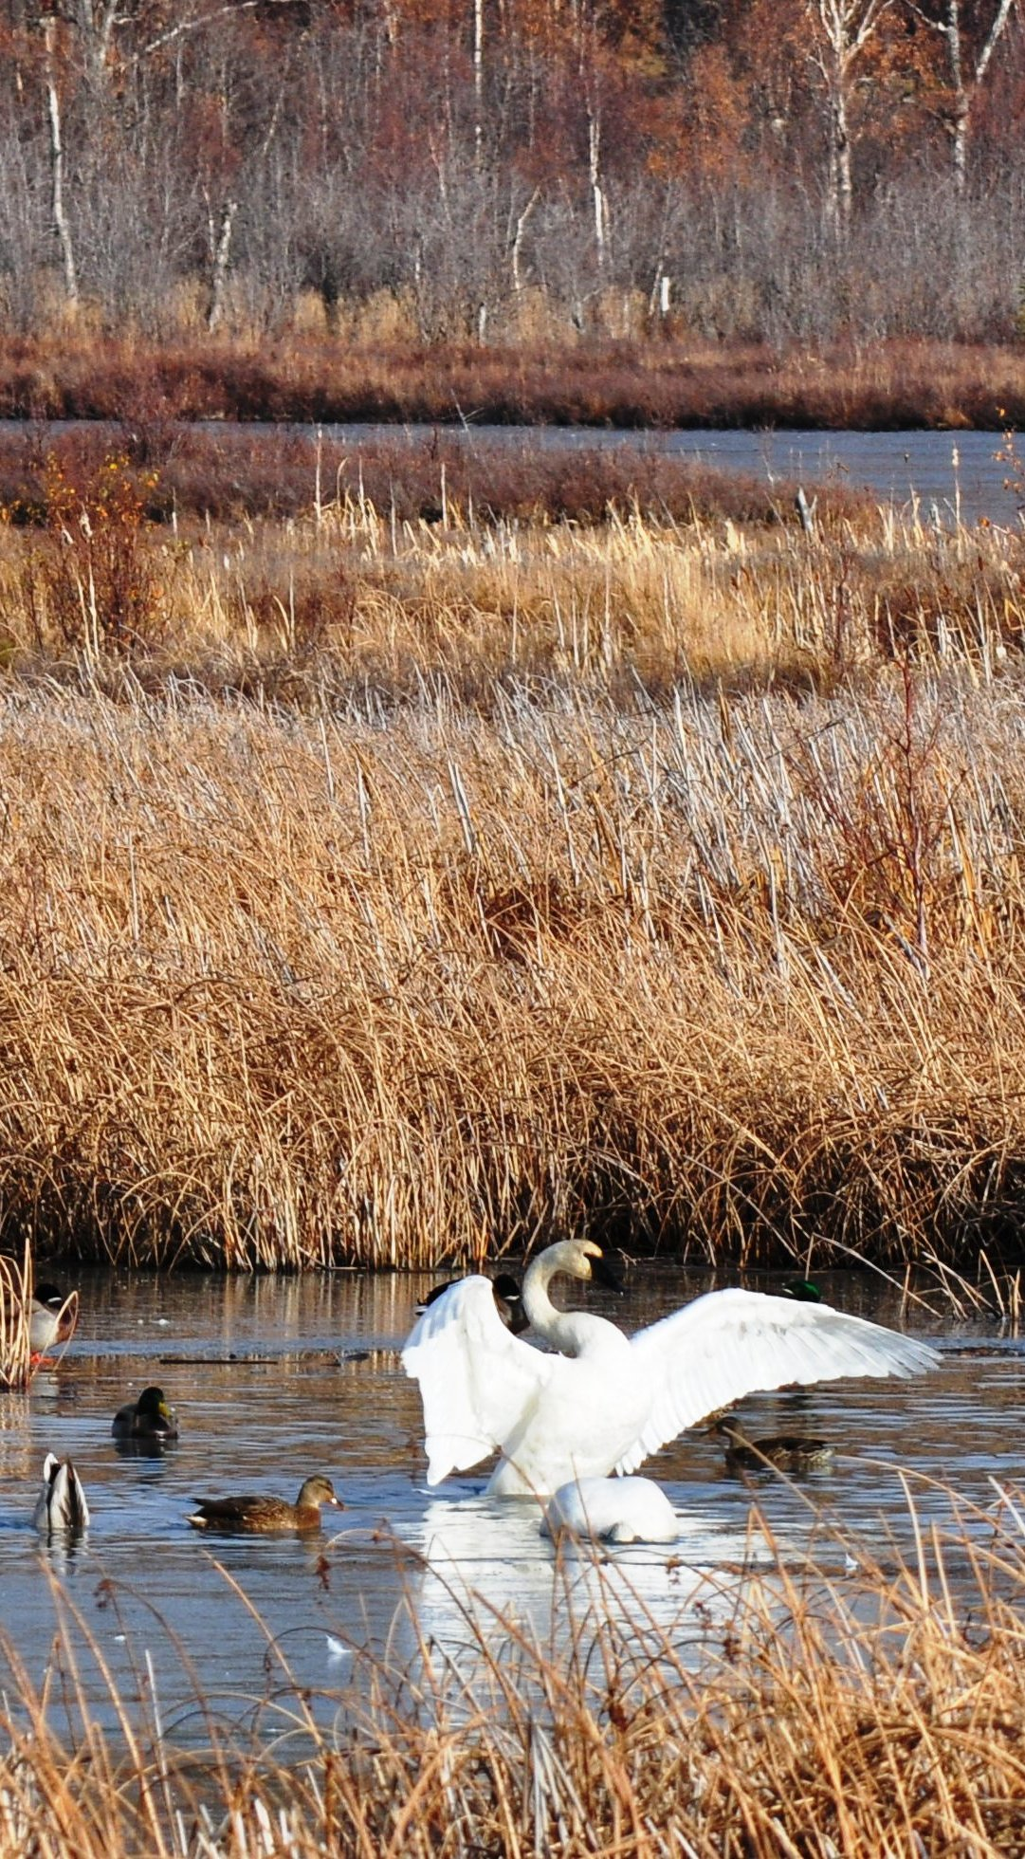
The End Purpose & Scope of the TRP Tier I-1

Slide 47
Background to the “Law”
1965/1976: SWDA & RCRA
The Solid Waste Disposal Act (SWDA) became law on October 20, 1965. It was a broad attempt to address the solid waste problems confronting the nation. The decade following its passage revealed that the SWDA was not sufficiently structured to resolve the growing mountain of waste disposal issues facing the country.
As a result, significant amendments were made to the act with the passage of the Resource Conservation and Recovery Act of 1976 (RCRA).

Slide 48
Background
RCRA:
EPA was charged with:
Developing the Subtitle C “cradle-to-grave” regulations of hazardous waste to include the storage, treatment, transport and disposal of hazardous wastes.
compliance and enforcement of hazardous waste regulations per Subtitle C;
Regulation of solid waste was largely delegated to the states per Subtitle D.

Slide 49
Background
RCRA
States were eligible to seek authorization to implement Subtitle C in lieu of the EPA.
Tribes were defined as a “municipality” under RCRA and are not eligible to seek such authorization.

Slide 50
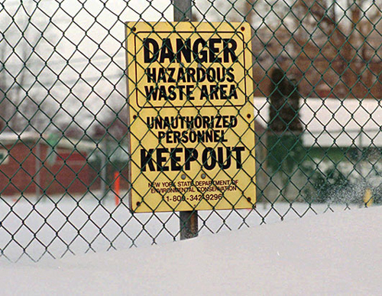
Background
1980: CERCLA (Superfund)
The U.S. Congress responded to the Love Canal in Buffalo, NY and other abandoned hazardous waste sites by enacting CERCLA, commonly referred to as “Superfund”.

Slide 51
Background
1980: CERCLA (Superfund)
CERCLA was intended to clean up the nation’s worst sites and identify responsible parties to bear the cost of cleanups.
A tax on chemicals was established to create the funding to conduct the assessments and cleanups which is the source of the term “Superfund”.
To implement this program the EPA developed the National Contingency Plan (NCP), promulgated as 40 CFR Part 300.

Slide 52
Background
1980: CERCLA (Superfund)
The NCP included a process to assess and rank sites that should be listed on the National Priority List (NPL) of the “worst hazardous waste sites” and a process to remediate those sites and recover the costs to replenish the “Superfund”.

Slide 53
Background
1980: RCRA Regulations
The first U.S. EPA regulations of hazardous wastes were published on May 19, 1980. This started the “cradle-to-grave” regulation of hazardous waste to include the storage, treatment, transport and disposal of hazardous wastes.
EPA was charged with compliance and enforcement of hazardous waste regulations per Subtitle C;
Regulation of solid waste was largely delegated to the states per Subtitle D.

Slide 54
Background
1995: Beginning of “Brownfields”
An adverse impact of the Superfund Program and it’s cost recovery program to pursue “responsible parties” for the costs of assessing and cleaning up the NPL sites was the avoidance of potentially contaminated sites by developers, real estate agents, lenders and insurance companies. This problem lead to some properties becoming known as a “brownfield”, which is the opposite of a “greenfield”.
(A greenfield is a general real estate term for undisturbed property with no potential contamination issues).

Slide 55
Background
1995: Beginning of “Brownfields”
In response to this problem the U.S. EPA administratively created the “brownfield pilot grant” program in 1995 to provide additional incentives for brownfields redevelopment. The purpose of these grants was to investigate property for potential contamination to facilitate its cleanup and reuse.

Slide 56
Background
1997: Brownfield Cleanups and TBAs
EPA began providing grants to state and local governments to establish revolving loan funds to fund site cleanup.
EPA also began providing pre-remedial site assessment funding for state and tribal conducted Targeted Brownfields Assessments (TBA).
Both activities were financed with Superfund appropriations and funded under CERCLA Section 104(d) cooperative agreement authority (grants).

Slide 57
Background
2002: The “Brownfield Law”
In conducting the congressional hearings that led up to the passage of the 2002 “Brownfield Law” it was stated in the legislative history: “The vast majority of contaminated sites across the Nation will not be cleaned up by the Superfund program. Instead, most sites will be cleaned up under State authority. For example, while there are an estimated 450,000 brownfield sites, there are fewer than 1,300 NPL sites.” (about 1303 sites in 2016)

Slide 58
Background
2002: The “Brownfield Law”
Congress: “Because the NCP (National Contingency Plan) is intended to address the nation’s worst hazardous waste sites, many of its requirements are not appropriate in the context of funding for brownfields assessment and remediation.”
In recognition of these facts, and the need to create and improve State and Tribal cleanup capacity, CERCLA was amended to add section 128(a) to provide financial assistance to States and Indian Tribes to establish or enhance response programs.

